Slide 1
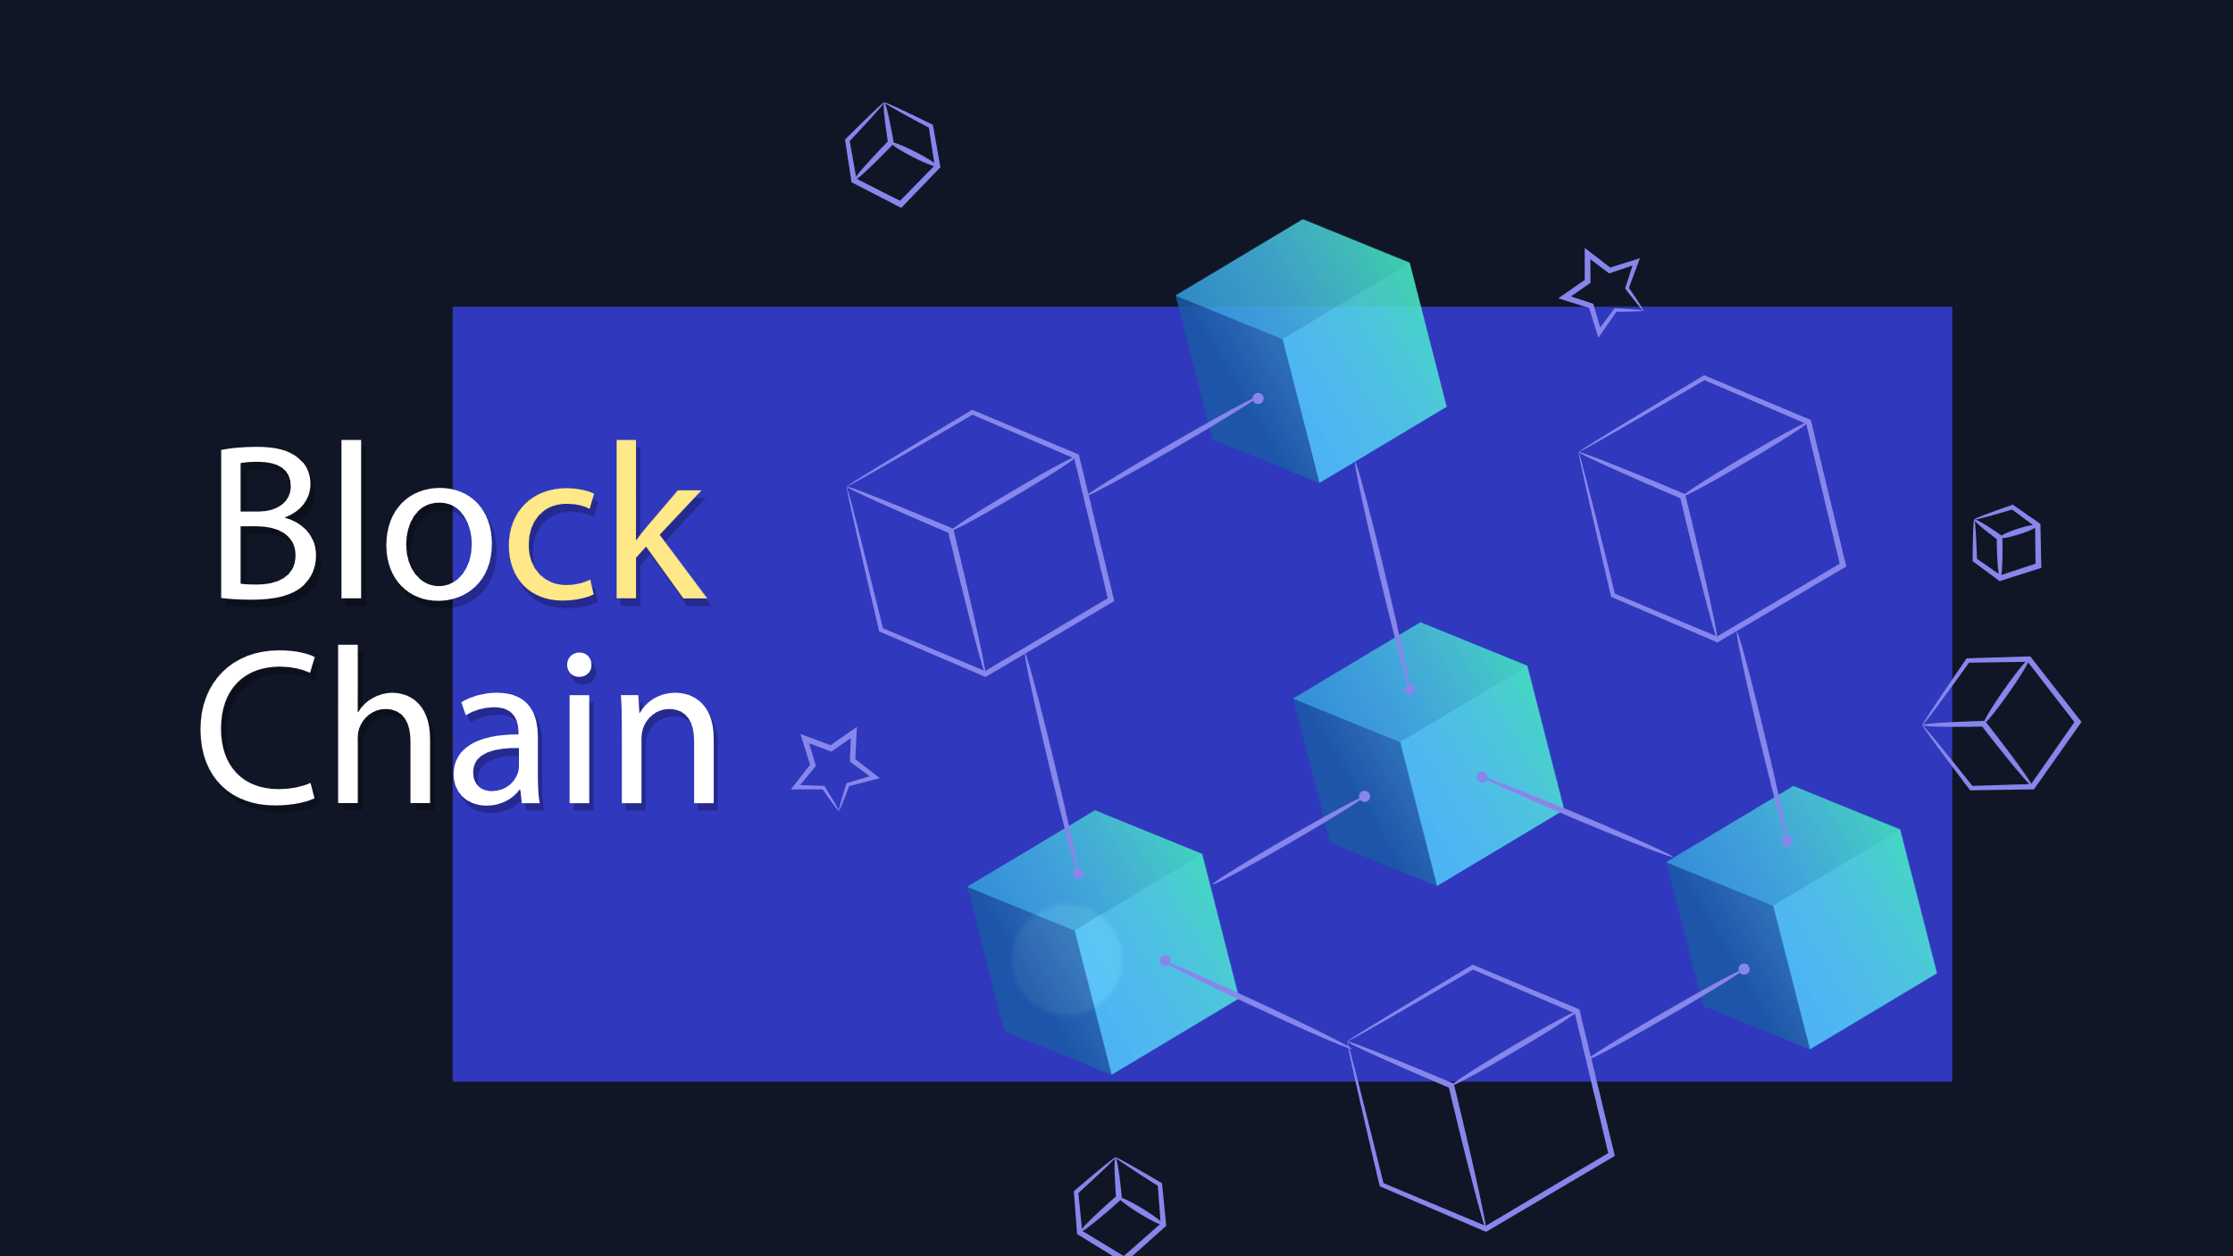
z

Slide 2
What is Block chain ?
Blockchain is a system of recording information in a way that makes it difficult or impossible to change, hack, or cheat the system. A blockchain is essentially a digital ledger of transactions that is duplicated and distributed across the entire network of computer systems on the blockchain
Each node has the entire database, whenever new
Data is to be added it is synced with each node.

Slide 3
Trust Frameworks and Consensus Mechanisms
Consensus, as a concept, is fundamental to any system where more than one entity is participating.
As a public blockchain aims to include any participant that runs a node, there is a need to quickly reach agreement on whether to accept a new block as part of the chain when it is mined. Without the ability to reach this agreement, the blockchain can not create new blocks. A consensus mechanism is a set of rules that allows multiple machines that are connected together to work together while tolerating some machines providing incorrect data or failing completely. A blockchain needs a consensus mechanism to ensure there are a set of rules for creating and accepting each newly created block.

Slide 4
Cryptography in block chain: Public Key Cryptography
If I want to send a message to someone on a public network like blockchain I’ll need two related cryptographic keys, a public one I can share with anyone who wants to send me a message, and a private one that I keep with myself. Let's call them public key A and private key A, because they're a matching pair, like a lock and key. Its a little confusing calling both keys because the public key is used a bit like a lock.
Public key A is used to encrypt or perhaps lock messages and private key A is decrypts messages but only if they were encrypted with the matching public key A. The public key is called that because it can be shared openly,

Slide 5
A third party may be able to see I am sending a message, but there is no way to tell what I’m saying. And since recipient used my public key A to encrypt the message, the only corresponding key that can decrypt it is private key A. And since I am the only one in possession of that, recipient can be assured that only I can read the message

Slide 6
Why Do I Need a Public and Private Key on the Blockchain?
When someone sends you crypto coins over the Blockchain, they are actually sending them to a hashed version of what’s known as the “Public Key”. There is another key which is hidden from them, that is known as the “Private Key.” This Private Key is used to derive the Public Key. You can know your own Private Key, and everyone else on the Blockchain knows their own Private Key, but the Private Key should not be shared with outsiders

Slide 7
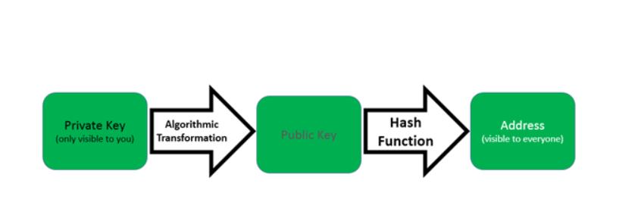
you sign the cryptocurrencies you send to others using a Private Key. If someone were to obtain your private key, they would be able to send your cryptocurrencies to themselves, verifying that transaction with the Private Key
The Private Key is used to mathematically derive the Public Key, which (along with information about the network and a checksum)is then transformed with a hash function to produce the address that other people can see. You receive cryptocurrencies that others send to your address (which is a result of the hash of your public key and some additional information).

Slide 8
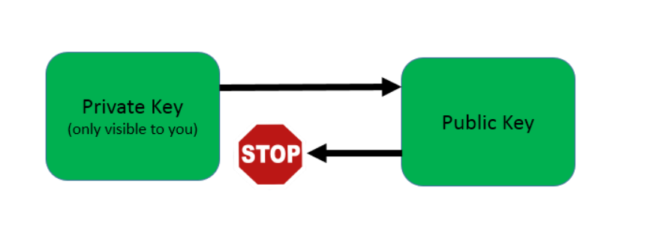
if a Public Key is derived from a Private Key, couldn’t someone create a reverse key generator?
Crypto currencies use a complicated algorithm to solver the issue, called RSA algorithm.
he algorithm makes it very easy to generate Public Keys from Private Keys, but it is very difficult to “reverse” the algorithm to accomplish the opposite.
the process of reversing the process is even more complex — so much so that the world’s most powerful computer would need more than 40000000000000000000000000000000 years (that’s 31 zeroes!) to complete this calculation.

Slide 9
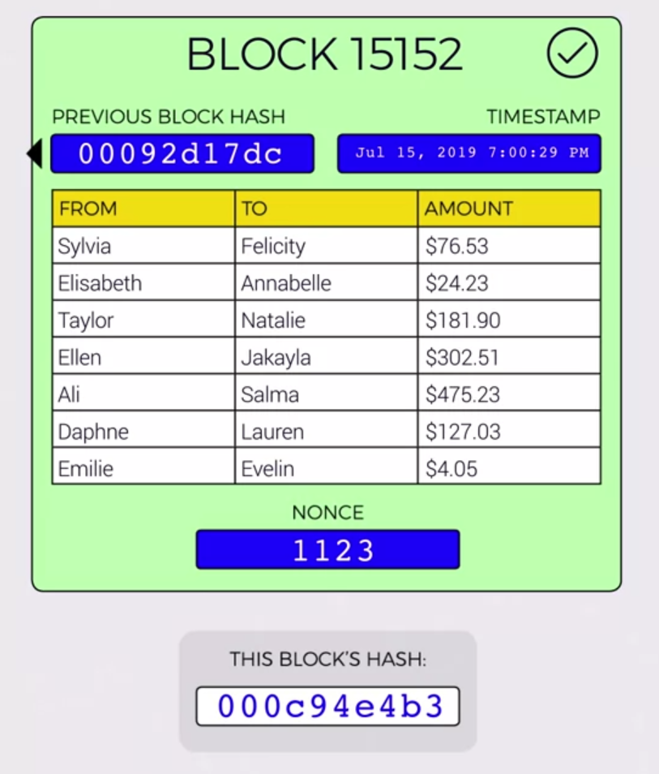
Anatomy of A Block
This example contains just seven transactions. Bitcoin blocks on the other hand contains somewhere up to 2,000 transactions per block, but this number varies between different blockchains and depends on block size limits. Block sizes are usually limited in order to prevent network congestion. Bitcoin currently has a block size limit of one megabyte. Every block has a unique number, also called its height. Since the blockchain is linear, these numbers again or heights increment. There can be only one block at a given height. Blocks also contain a timestamp, a strange number called a nonce, some other information not listed here and
critically a hash of the previous block in the chain

Slide 10
VALIDITY In Blockchain
You've probably heard of Bitcoin miners. Well, finding a valid block is the hard work that those miners are doing when they mine. Blockchains have what's called a difficulty, which is essentially an arbitrary setting that determines how hard it is to create blocks. This is where all the value comes from. If anyone could just create blocks and throw them on the chain, there would be no value there, and networks would never agree on which blocks should go on the chain.
Having created a block means you must have done a bunch of work. That's what proof-of-work means.
By finding a block that is valid, you have proven that work has been done. For blockchains like Bitcoin and Ethereum, the difficulty level can change in order to ensure that blocks are created at regular intervals.

Slide 11
Creating a Valid Block
The way you determine if this block is valid, is you simply ask is this block's hash below the difficulty threshold? We can see that our block's hash is larger than our threshold number, so this block is not valid. In our example we need the first three digits of the hashed to be zero for the block to be considered valid. Like what we see in the previous block's hash. The greater the difficulty, the lower the hash output number would have to be for the block to be valid.

Slide 12
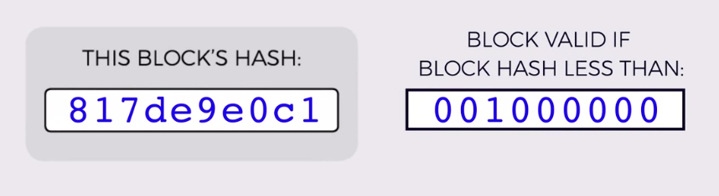
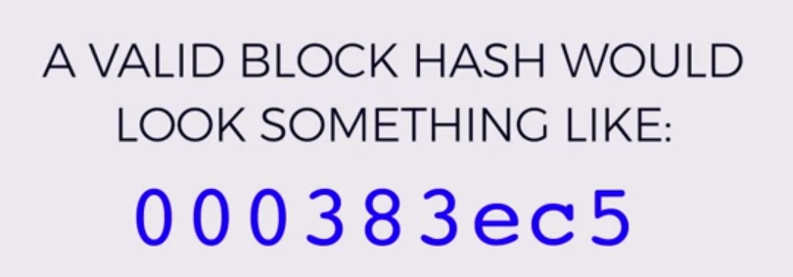
The way you determine if this block is valid, is you simply ask is this block's hash below the difficulty threshold? We can see that our block's hash is larger than our threshold number, so this block is not valid.
In our example we need the first three digits of the hashed to be zero for the block to be considered valid.
The greater the difficulty, the lower the hash output number would have to be for the block to be valid.
Since hashes are effectively random, lower values are harder to find. It's like rolling a die. It's harder to roll a two or below than it is to roll a three or below you can think of each hash digit as being like rolling a 16-sided die. To get three zeros like we need, you'd have to roll three 16-sided dice and get three once,
since there's no zeros on a die. As you can imagine you'd have to roll the dice quite a few
times around 4,000 times for that to happen.

Slide 13
How exactly do we change HASH?
But in order to do that with our block, we don't roll dice, we can only change the data and see if we happen to get a valid hash, and do it over and over again. But what data can you change in your block?
It contains important transaction data that you can't alter. Well, this is where the nonce comes in.
The nonce is there just so that miners have a piece of data that they can essentially play with.
They can change it randomly to change the block's output hash until they luck out and happened to find one that is below the required difficulty threshold. Once they have found a nonce that results in
their block's hash being below the difficulty threshold, the block is finally considered valid and it can be broadcast to the network with that miner taking a reward for their effort

Slide 14

When other nodes on the network received a valid block, they can very easily check its validity by simply hashing the block themselves, and ensuring that it's below the target difficulty. If it is,
it's added to their blockchain and work starts on
the next block, and that next block will include
that previous block's hash in its own data which
ensures the continuity of the blockchain.
If it is, it's added to their blockchain and work starts on the next block, and that next block will include
that previous block's hash in its own data which ensures the continuity of the blockchain.

Slide 15
Public, Consortium & Private Blockchains
Due to the transparency of a blockchain and the need to involve a community of computers in order to bring the blockchain to consensus, companies and governments have introduced the idea of private blockchains.
Differences between public vs. private blockchains boil down to the participants of the network. Public blockchains allow anyone to take part in block creation as long as they adhere to the network’s protocol. Private blockchains only grant the power of block creation to a set number of participants. Public blockchains maintain protocol specification and decentralization with consensus algorithms like proof of work, while private blockchains could have a single entity responsible for syncing the blockchain. When specific nodes are given the authority for the creation of new blocks, this is consensus mechanism is called proof of authority.
With a consortium blockchain, the consensus mechanisms of this blockchain are controlled by a limited set of nodes. The right to access the blockchain can either be restricted to the predetermined set of nodes or to the public (or to a mix of these rights). Considering these possibilities, consortium blockchains can be thought of as partially decentralized.

Slide 16
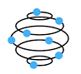
Public Blockchain
This blockchain is a permissionless, non-restrictive, distributed ledger system, which means anyone who is connected to the internet can join a blockchain network and become a part of it. The basic use of such blockchain is for exchanging cryptocurrencies and mining.

Slide 17
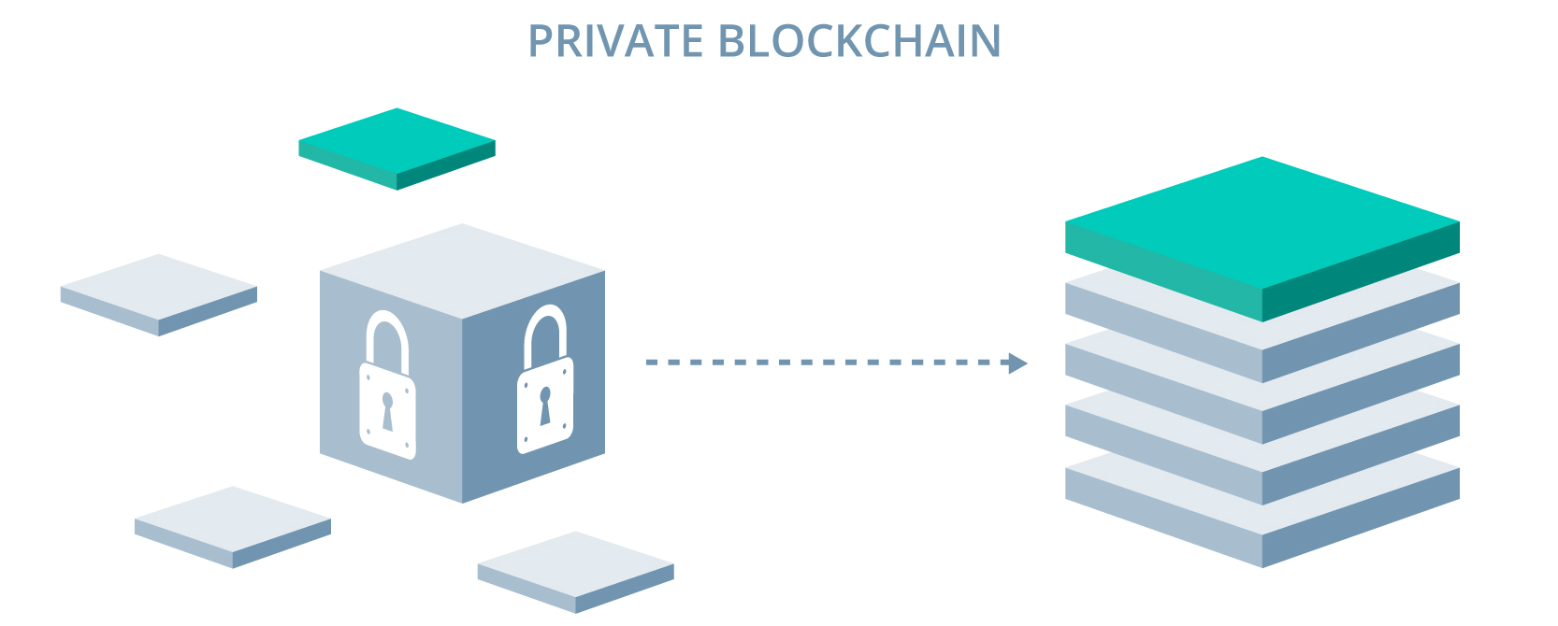
Private Blockchain
Unlike the public, a private blockchain is a permission and a restrictive blockchain that operates in a closed network. Such blockchain is mostly used within an organization where only particular members are participants of a blockchain network. It is best suited for enterprises and businesses that want to use blockchain only for internal uses. The major difference between the blockchains is that the public is highly accessible, whereas private is confined to a particular group of people.

Slide 18
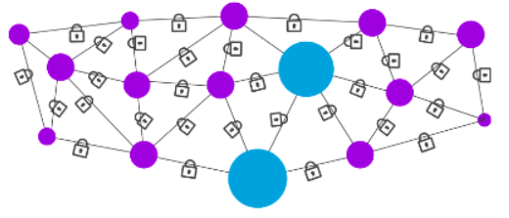
Consortium Blockchain
Consortium blockchain(also called federated blockchains) is best suited for organizations where there is a need for both types of blockchains, i.e., public and private. In this type, there is more than one central in-charge, or we can say more than one organization involved who provides access to pre-selected nodes for reading, writing, and auditing the blockchain. Since there is no single authority governing the control, it maintains decentralized nature.

Slide 19
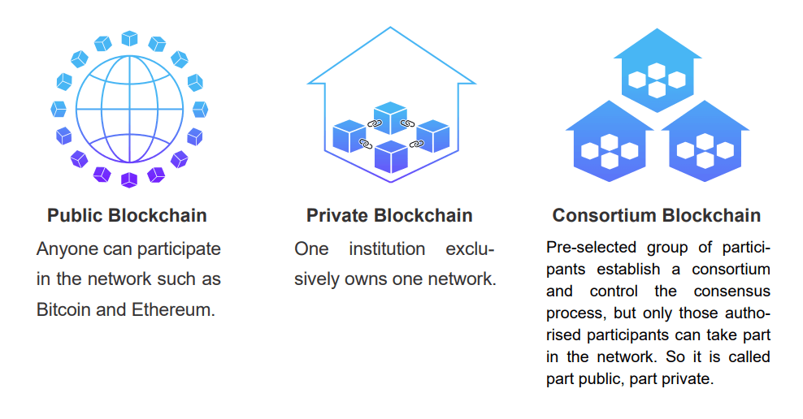
While public blockchains are typically advertised as completely decentralized, private blockchains have more tightly controlled permissions while still maintaining the decentralization principles that classic blockchains provide users with.
Given the nature of a private blockchain, attacks would come from validators that are known to the network, since only validators with permission to participate are able to. Therefore, there is a reduced reliance on crypto economics to create incentives and disincentives for validators, as they were specifically granted access to the network. Private blockchains also have the capability to blacklist certain users. Additionally, the predetermined controllers of the network can very easily make changes to the blockchain if needed. Due to the smaller number of contributors to the network, transactions are often not as energy intensive, process faster, and faults within the network are more easily rectified. The tradeoff is the lack of transparency and decentralization

Slide 20
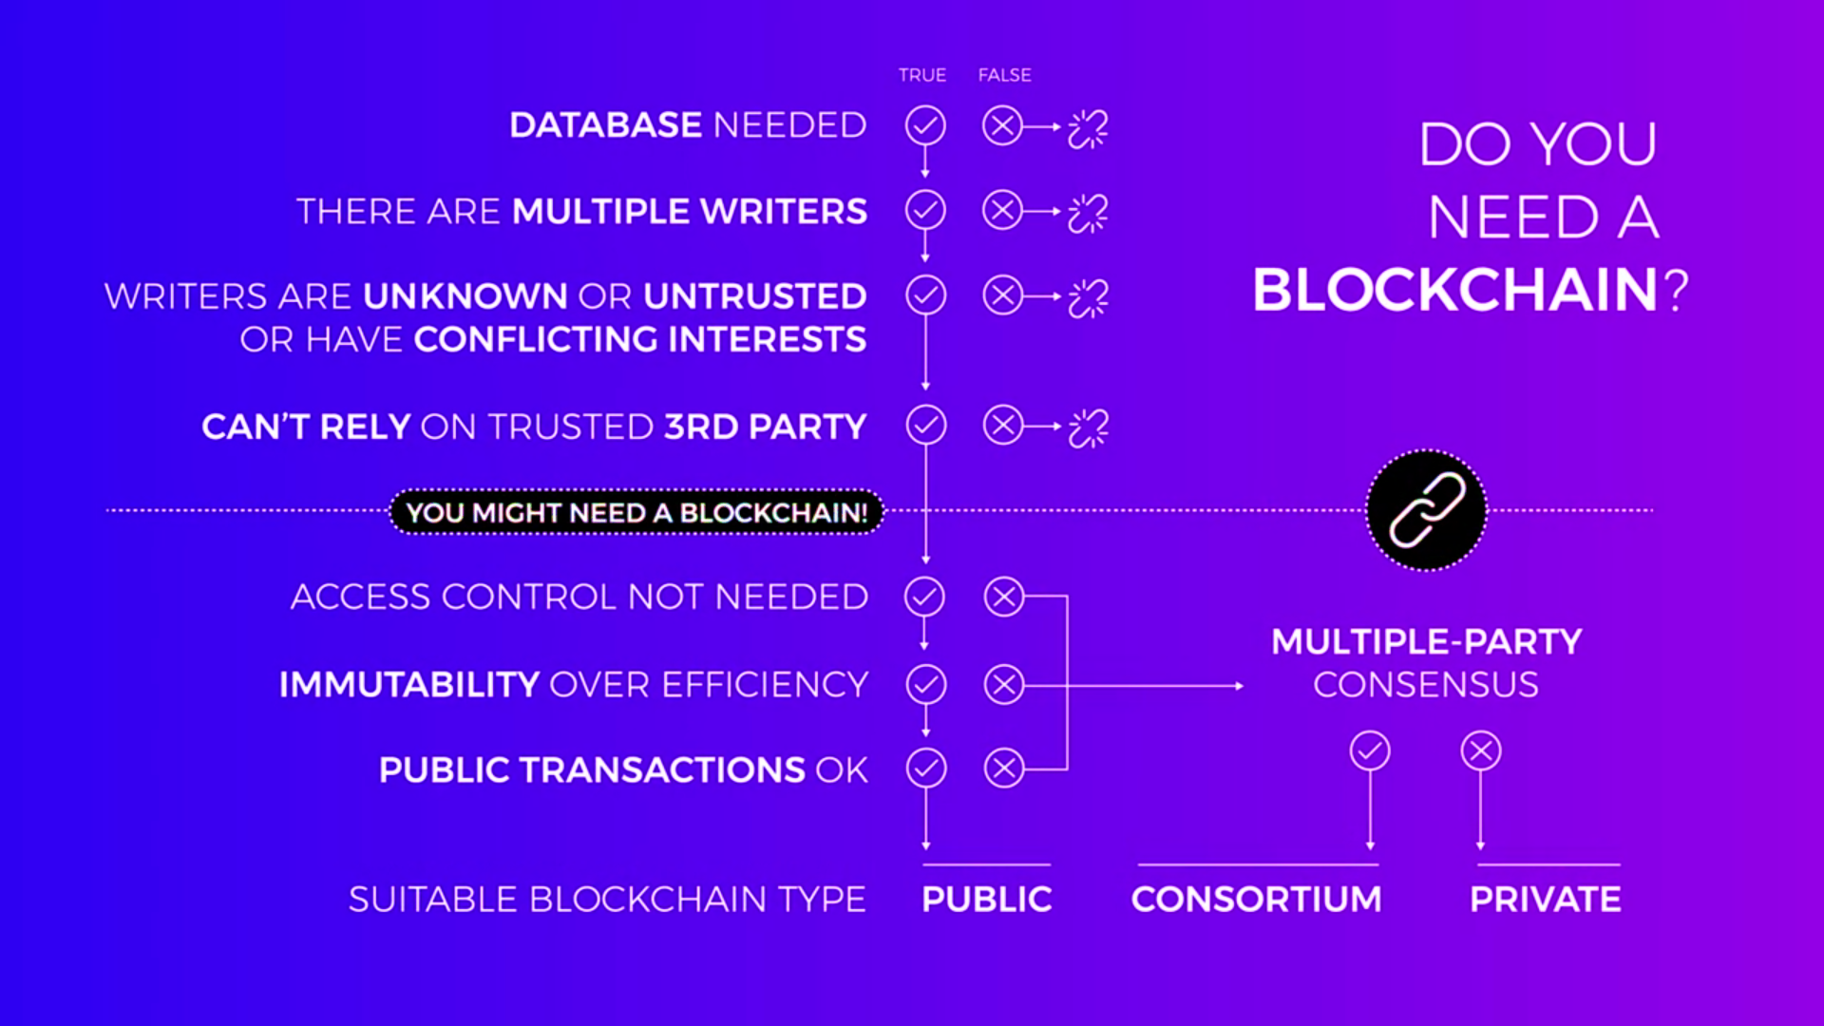

Slide 21
Block Chain in real world
In the last decade much of the internet has moved onto "cloud storage" which has powered the new web. Most of the applications we use on a daily basis have our data stored in server farms owned by Amazon, Google, or Microsoft. In this new era of decentralized applications, developers are turning to decentralized storage as a way to avoid censorship, server outages, and hacks.
Instead of a central server, a peer to peer network is used to establish connections. Public key cryptography is built into the node addressing system and content addressing is used to index content. Both node and content addresses are stored in a decentralized naming system called Interplanetary Naming System (IPNS).

Slide 22

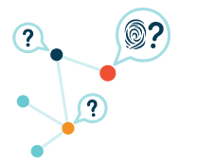
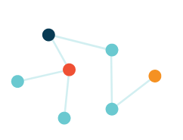
IPFS
When you add a file to IPFS, your file is split into smaller chunks, cryptographically hashed, and given a unique fingerprint called a content identifier (CID). This CID acts as an permanent record of your file as it exists at that point in time.
When other nodes look up your file, they ask their peer nodes who's storing the content referenced by the file's CID. When they view or download your file, they cache a copy — and become another provider of your content until their cache is cleared.
A node can pin content in order to keep (and provide) it forever, or discard content it hasn't used in a while to save space. This means each node in the network stores only content it is interested in, plus some indexing information that helps figure out which node is storing what.

Slide 23

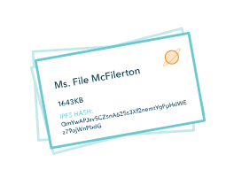
IPFS
If you add a new version of your file to IPFS, its cryptographic hash is different, and so it gets a new CID. This means files stored on IPFS are resistant to tampering and censorship — any changes to a file don't overwrite the original, and common chunks across files can be reused in order to minimize storage costs.
However, this doesn't mean you need to remember a long string of CIDs — IPFS can find the latest version of your file using the IPNS decentralized naming system, and DNSLink can be used to map CIDs to human-readable DNS names.

Slide 24
Smart Contracts
A small piece of logic or code that can interact with a block chain. A smart contract might, for example, be programmed to automatically split a payment sent to an address on a blockchain between you and someone else.

Slide 25
Smart Contracts are just programmed and work without interference of a third party.
They are beneficial when the parties involved have conflicting interests, and can be used as an intermediary.
- A smart contract’s logic is publicly viewable by both you and your friend. So, you can each confirm that it will operate as expected. It's fully transparent, trustless, and secure and because the blockchain is immutable so is the logic of the smart contract. Neither you nor your friend can go back and change it after the fact.

Slide 26
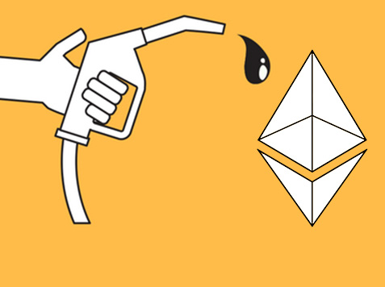
Fees of Smart Contract
As of today, the smart contract processed on the Ethereum virtual machine(EVM) are not free. You pay with gas fees. like a transaction fee for computation. If the EVM is the engine of Ethereum, then gas is the gas. Gas is a small amount of ether, the currency and Ethereum, allocated to pay for computation that is performed on the network.
This serves three primary functions.
It incentivizes nodes to perform computation by providing them
with compensation.
2) It reduces the incidence of spam and abuse
as the rewards of spamming would be outweighed by the cost of gas.
3) It helps to prevent the EVM from being programmed into
an infinite loop since the gas for a given process would get used up.

